Slide 1
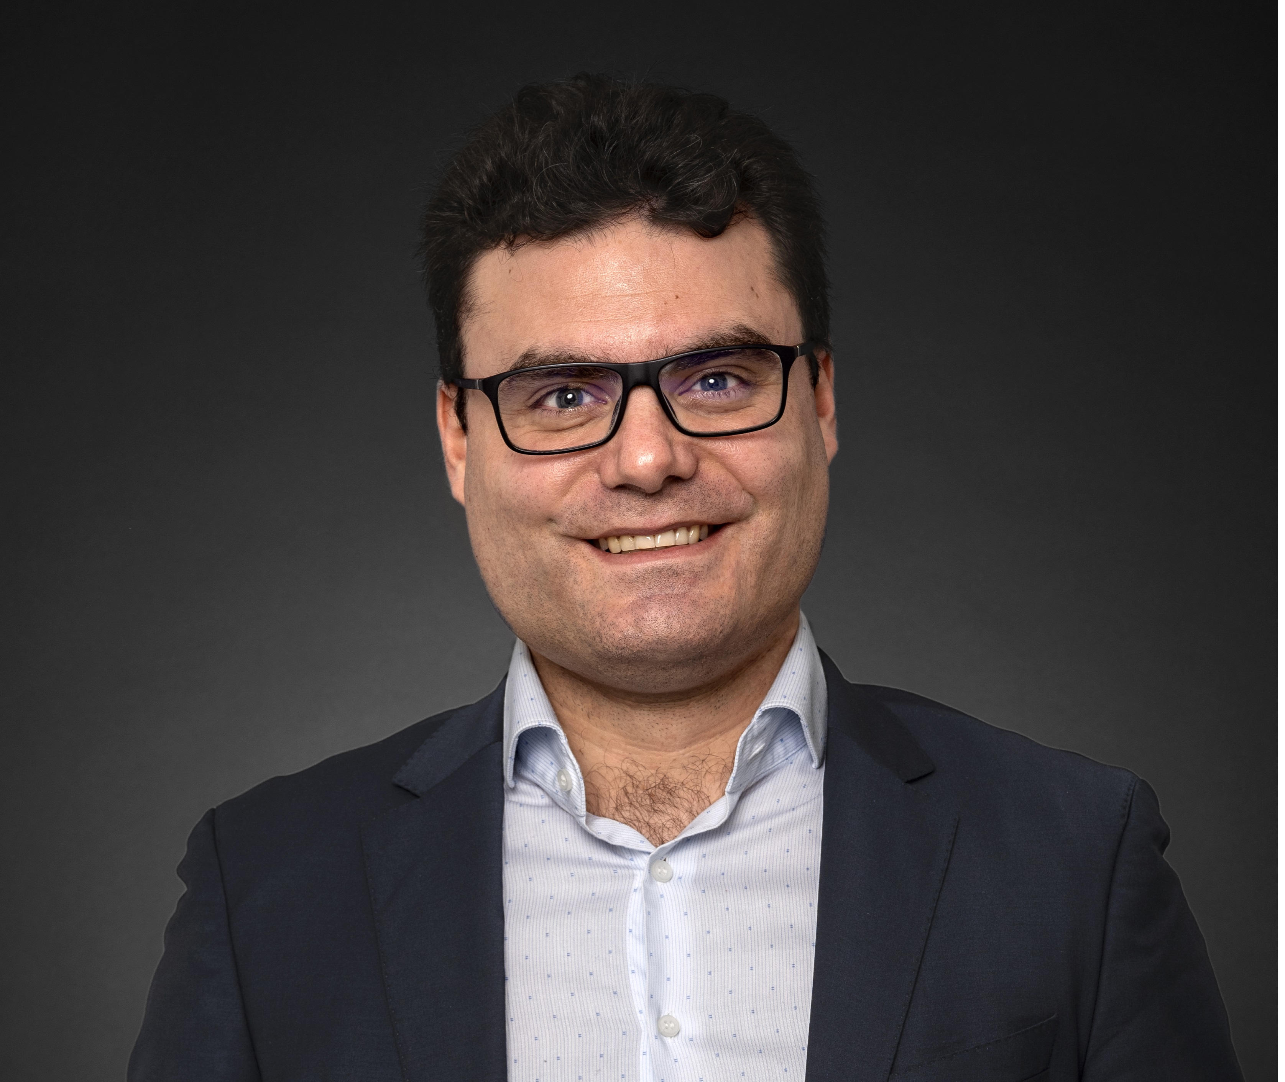



Jérôme TASSI
Lawyer (Paris)
IP Expert
Jerome.tassi@agilit.law
T : +33 (0) 1 81 70 99 24
IP damages assessment: a French perspective
10 June 2022

Slide 2
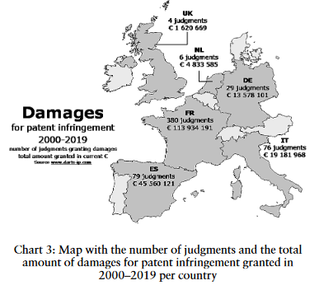
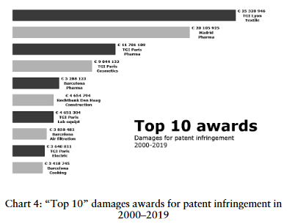
A French perspective
Survey by Pierre VERON, WHAT PRICE CRIME? A European hit parade of patent infringement damages, GRUR 2/2021

Slide 3
A French perspective
Procédural topics
Statute of limitation
Five years
Starting point: last infringement fact
Tools to collect evidence
No discovery or disclosure
« Saisie-contrefaçon » (i.e order to preserve evidence)
When?
Straightforward cases: in the main decision
Current practice: in case of infringement, the Court orders the defendant to provide financial information (in order to settle the case)
Right of information (can be used to determine the extent of the infringement)
Complex cases: expert appointed by the Court

Slide 4
A French perspective
Legal provisions (identical for all IP rights)
“In order to set damages, the court separately takes into account:
1° Negative economic consequences of the infringement, including lost profits and losses suffered by the harmed party;
2° Moral prejudice inflicted to said party;
3° And profits made by the infringer, including savings on intellectual, material and promotional investments made owing to the infringement.
However, the court may, alternatively and upon request of the harmed party, grant a lump sum in terms of damages. This lump sum is higher than the amount of royalties or rights which would have been due if the infringer had asked for the authorization to use the right that it infringed. This sum does not exclude the further indemnification of the moral prejudice of the harmed party.”

Slide 5
A French perspective
Legal provisions (identical for all IP rights)
Article 13(2) of the Enforcement Directive: “Where the infringer did not knowingly, or with reasonable grounds to know, engage in infringing activity, Member States may lay down that the judicial authorities may order the recovery of profits or the payment of damages, which may be pre-established.”
No implementation in France
Good faith is not taken into account when assessing damages

Slide 6

A French perspective
Main method (implementation of Article 13.1 (a))
IP rightholder prejudice + infringer profits ?
    : no automatic addition of these damages
Three-steps method for the lost profits:
(1) Report rate (generally between 30 and 90%)
Paris Court of Appeal, 2018: « “the report rate is intended to determine whether the patentee could have made all of the sales of infringing products and should take into account the patentee's manufacturing and marketing capacity and the commercial advantage conferred by the patent”
(2) Total infringing sales
(3) Gross profit of the IP rightholder
Lost profits: (1) X (2) X (3) + lost royalty on the remaining sales

Slide 7
A French perspective
Main method (implementation of Article 13.1 (a))
« Losses suffered by the harmed party »:
Price erosion
Depreciation of the IP right
Loss of chance to assign or license the IP right
Moral damage : no consistent method of assessment (between € 5000 and 30000)
Profits made by the infringer (new in France since 2007). Punitive damages prohibited.
Case law: not all the profits since a part of these profits may not be the result of the infringement, but from the infringer's own efforts.

Slide 8
A French perspective
Alternative method: the « lump sum » (implementation of Article 13.1 (b))
Upon request of the claimant
No statistics, but probably around 10% of the IP cases
Versailles Court of Appeal, 15/03/2022 : « this method is intended, in particular, to allow for compensation of damages in the event that evidence is lacking to accurately assess the damage suffered by the rights holder”
Basis of this method: turnover of the infringer
Determination of the contactual royalty rate (expert opinion, pre-contractual discussions, other licensees, comparables, economic value of the IP right)

Slide 9
A French perspective
Alternative method: the « lump sum » (implementation of Article 13.1 (b))
Burden of proof of the contractual rate: IP right holder but the defendant must explain why he challenges this rate
Paris Court of first instance, 07/06/2018 : “the defendant does not provide any information on the royalty rates used in pharmacy, so that the rate of 40% (i.e. twice the 20% proposed by NOVARTIS AG to take into account the damage suffered and including the moral damage suffered) will be retained”.
Paris Court of first instance, 18/11/2021: “With regard to the royalty rate, it is not disputed, other than by way of general assertions, that it is generally and usually comprised, in the sector concerned, between 5 and 10% of the net sales made by the licensee company. In accordance with the terms of Article L. 331-1-3 of the Intellectual Property Code, this royalty rate should be increased to 12%.”

Slide 10
A French perspective
Alternative method: the « lump sum » (implementation of Article 13.1 (b))
Increasing the contractual rate (average of 50%, up to 100%)
Decision | IP right | Contractual royalty rate | Increased royalty rate
Paris Judicial Court, 14/04/2022 | Design | Unspecified | 20%
Paris Judicial Court, 18/11/2021 | Copyright | 5-10% | 12%
Paris Judicial Court, 07/01/2021 (overturned in appeal) | Patent (drugs) | Unspecified | 25%
Nanterre First instance Court, 28/11/2019 | Trademark (cosmetics) | 5% | 10%
Paris First instance Court, 07/06/2018 | Patent (drugs) | 20% | 40%
Paris Court of Appeal, 27/06/2017 | Patent (mechanical) | 1,5% | 4,5%

